Slide 1

Cervical Cancer
How We Can Prevent It
Dr Quek Swee Chong
Himalayan Women’s Health Project
30 August 2014

Slide 2
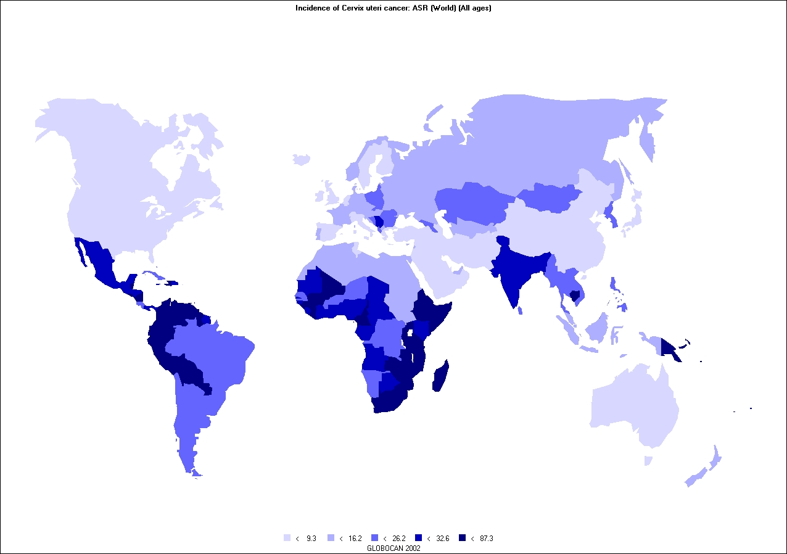
Cervical Cancer Incidence
Worldwide, every two minutes a woman dies of cervical cancer
In Asia Pacific, every four minutes a woman dies of cervical cancer
Age standardised rate (ASR) per 100,000 population (All ages)
Ferlay J et al. Globocan 2002; IARC 2004.
Notes:
Global incidence
The incidence of cervical cancer varies widely around the world, with the highest incidence in developing countries. Incidence rates exceeding > 30 cases per 100,000 population occur in Latin America and Sub-Saharan Africa with lower incidences observed in Western Europe, North America and Japan. The incidence rates for each country are available from the IARC database.
The main reason for these variations in incidence is the availability of screening programmes in developed countries but not in poorer developing countries. Screening can detect the early signs of cervical cancer, allowing for prompt treatment to prevent the development of invasive and potentially fatal cervical cancer.
It is important to understand that these figures are not necessarily accurate everywhere. They are sourced from WHO and IARC data, which varies in quality depending on country. Data from Finland, for example, will be perfect because they have good records systems and all cancers are routinely reported. In India, by contrast, very few centres report into data sources and in some areas of Africa, incidence figures are an estimate only due to the lack of availability of cancer registries or other reporting mechanisms. Likewise, the incidence in China is reported to be low, but may be due to under-reporting.
Ferlay J et al. Globocan 2002. IARCPress 2004.

Slide 3
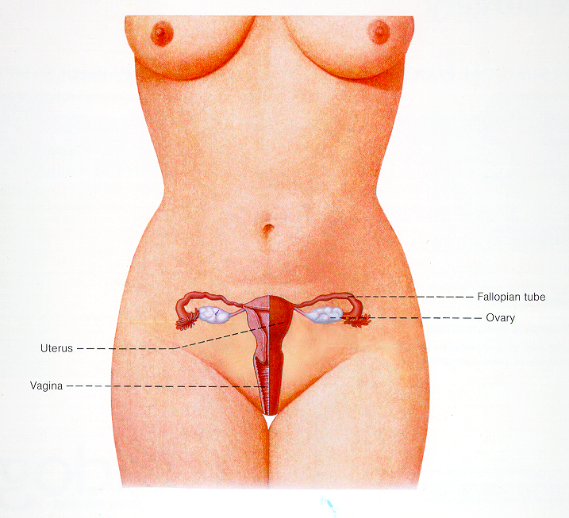
Female Anatomy

Slide 4
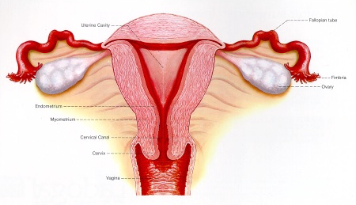
Female Anatomy

Slide 5
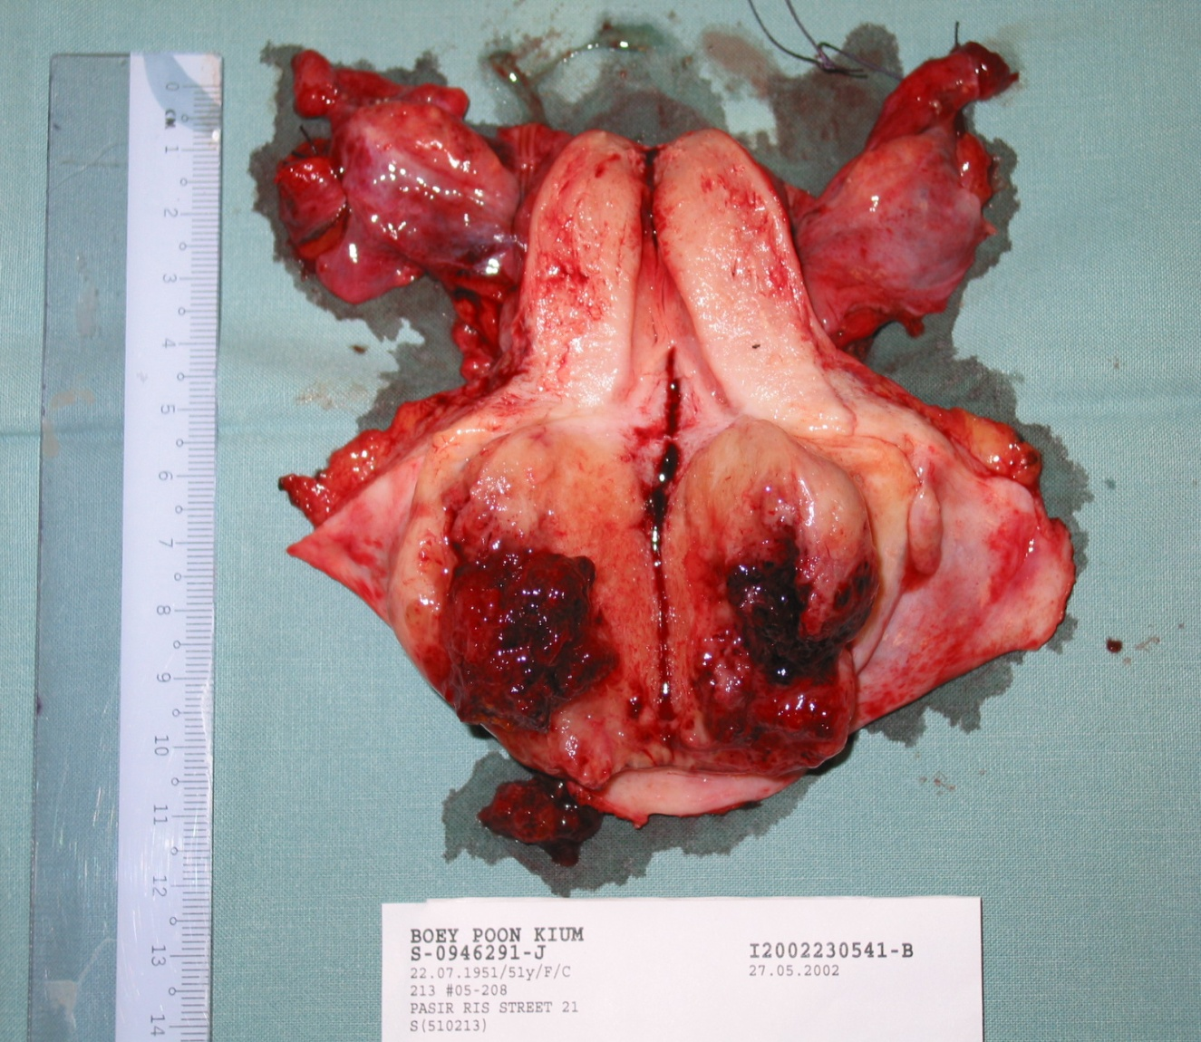
Cervical Cancer
India has one of the highest incidences in the world
Women often diagnosed late
Cure often not posible

Slide 6
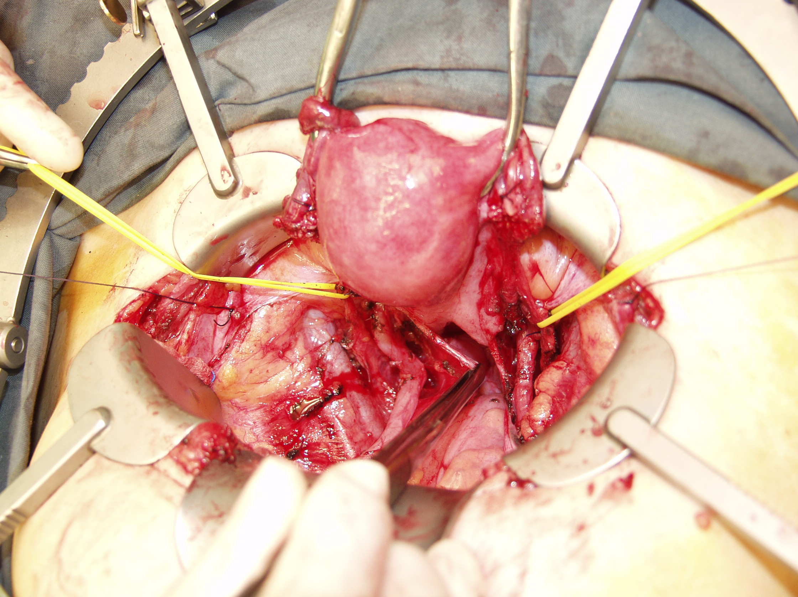

Slide 7
STOP
Cervical cancer
can be prevented ........

Slide 8
Purpose of Screening
Early detection of disease
Early Treatment
Early Treatment
Better Health

Slide 9
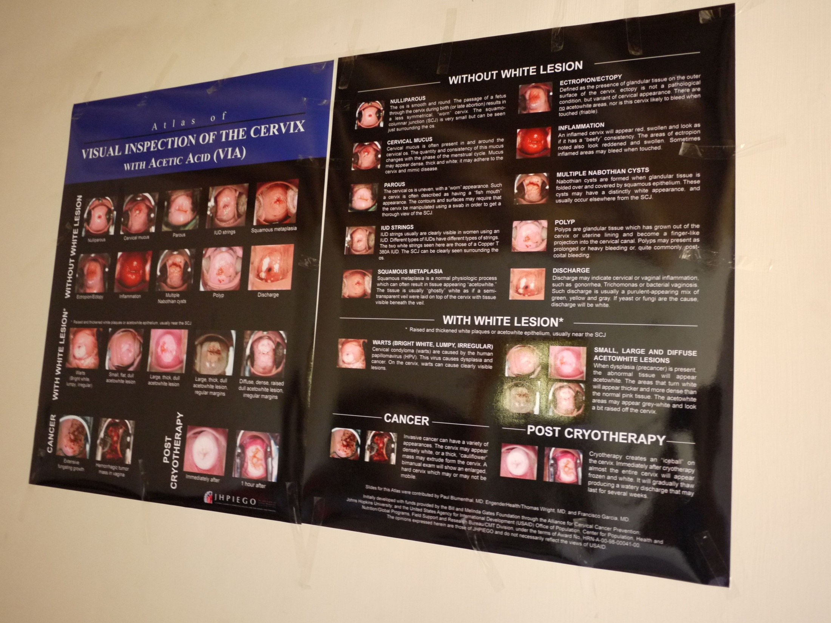

Slide 10
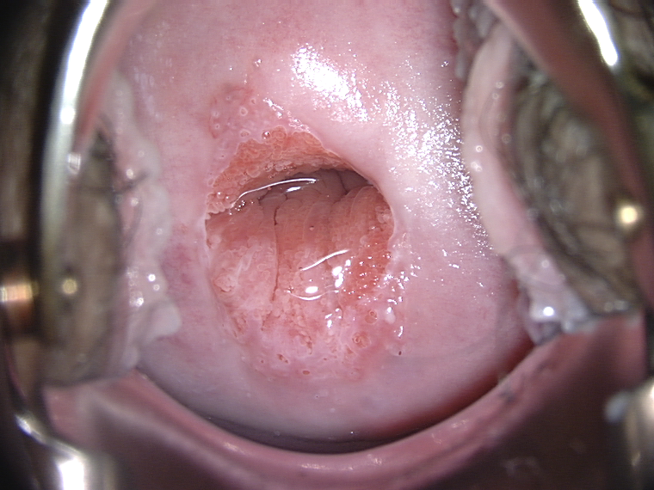
Normal Cervix

Slide 11
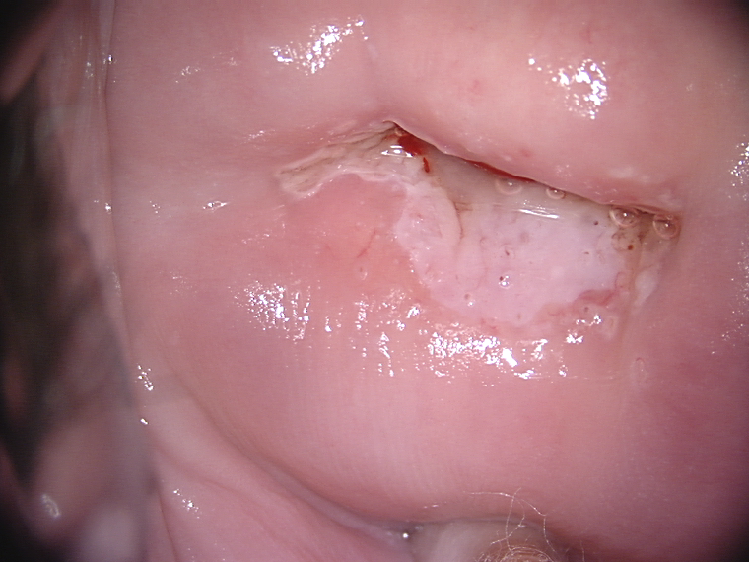
Small Pre-cancer

Slide 12
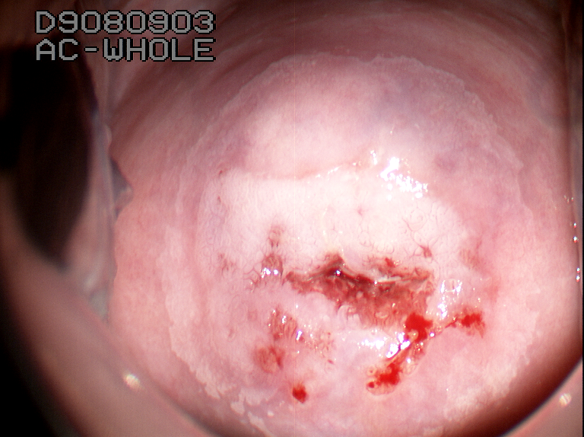
Large Pre-cancer

Slide 13
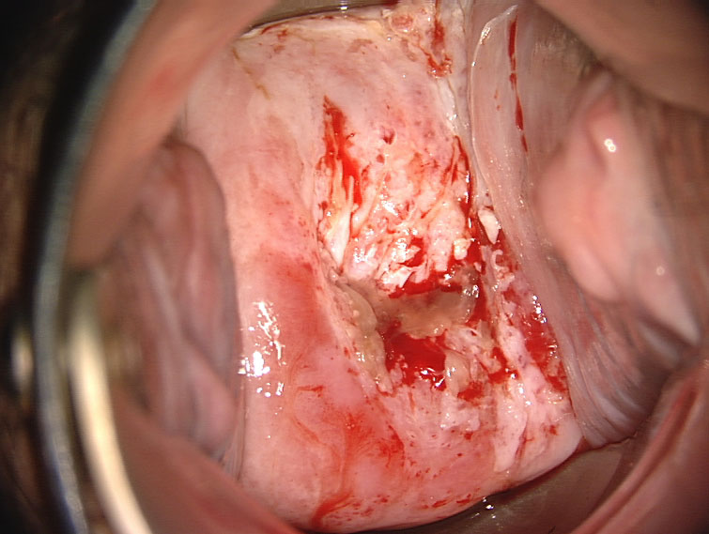
Cancer of the Cervix

Slide 14
Warning Signs
In the early pre-cancer stages there are no symptoms
By the time symptoms occur, it may be too late
  Bleeding between periods
  Bleeding after sex
  Bleeding after menopause

Slide 15
Himalayan Womens Health Project – Nubra Valley
Year | Women Screened | LEEP procedures | Rough Prevalence of Precancer (%)
2010 | 200 | 25 | 12.5
2011 | 1500 | 50 | 3.3
2012 | 500 | 30 | 6.0

Slide 16
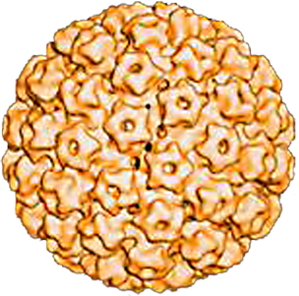
What Causes Cervical Cancer?
A Virus called Human Papillomavirus (HPV)
Many types of HPV but not all cause cancer
Very common infection (80% all women) but fortunately most will clear by itself
15 high risk types are known to cause cancer
HPV 16 and HPV 18 are the most dangerous and cause more than 70% of all cervical cancers

Slide 17
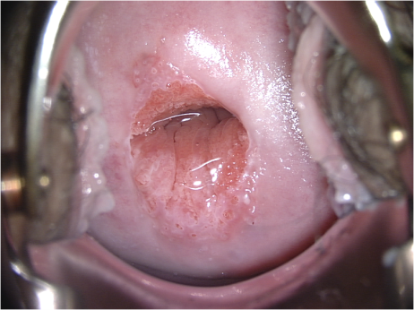
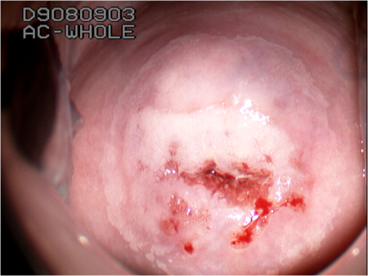
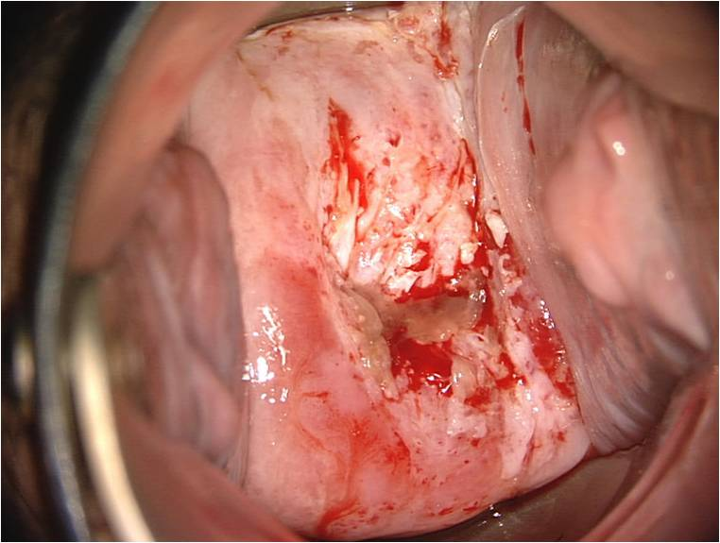
Normal Cervix ⇒ Pre-cancer ⇒ Cancer
Development of Cancer
Persistence
HPV
Clearance
Treatment for pre-cancer is almost 100% effective

Slide 18
Best Strategy – VIA & Vaccination
Screening by VIA or pap smear is looking for the pre-cancer
Vaccination prevents the pre-cancer occurring in the first place
Healthy
HPV vaccine
⇒
Primary prevention
⇓
Pre-cancer
VIA or pap
⇒
Secondary prevention
⇓
Cancer
⇒
Treatment
⇓
Debilitation/death

Slide 19
What is a vaccine?
Common medicine given to prevent infection
Safely given to millions of children & adults
Vaccine tricks the body into believing that a real infection has occurred, so it produces antibodies which prevent the infection from occuring again

Slide 20
HPV Vaccines
Injections developed to prevent infection with the most common HPV types that can cause disease
Uses the empty shell of the virus, so no real infection occurs
Can prevent around 70-80% of cervical cancer
3 doses given over 6 months for 15 years and older
Only 2 doses needed for girls aged 11-14

Slide 21
World Health Organisation Position on Safety
WHO has a committee on safety of vaccines (GACVS)
Concluded that HPV vaccines have a good safety profile

Slide 22
Worldwide Acceptance
Used in hundreds of countries worldwide
Many countries have national vaccination programmes e.g. United Kingdom, Australia, USA
HPV vaccines have been approved in India and are being used in many big cities

Slide 23
Age Groups for Vaccination
Best to give it to young girls before they get married or start having sex
Many countries like Australia and UK vaccinate their young girls in school around age 11-12
Older girls and women can also have the vaccine

Slide 24
Summary
Cervical cancer is a leading cause of death
Pre cancer stage is easily detected by screening
Pre Cancer stage is completely curable and so prevent cancer from occurring
HPV Vaccines available to prevent the majority of cancers

Slide 25

Thank You

